Slide 1



Newton’s 2nd Law Notes
An object accelerates when a net force acts on it.

Slide 2


Recall the definition of acceleration:
The cause of acceleration is force.
Unbalanced forces acting on an object cause the object to accelerate.

Slide 3
Force Causes Acceleration
  Acceleration depends on the net force.
  To increase the acceleration of an object, you must increase the net force acting on it.
  An object’s acceleration is directly proportional to the net force acting on it:
acceleration ~ net force
(The symbol ~ stands for “is directly proportional to.”)

Slide 4


Mass Resists Acceleration
For a constant force, an increase in the mass will result in a decrease in the acceleration.
Push on an empty shopping cart. Then push equally hard on a heavily loaded shopping cart.
The loaded shopping cart will accelerate much less than the empty cart.
Acceleration depends on the mass being pushed.

Slide 5
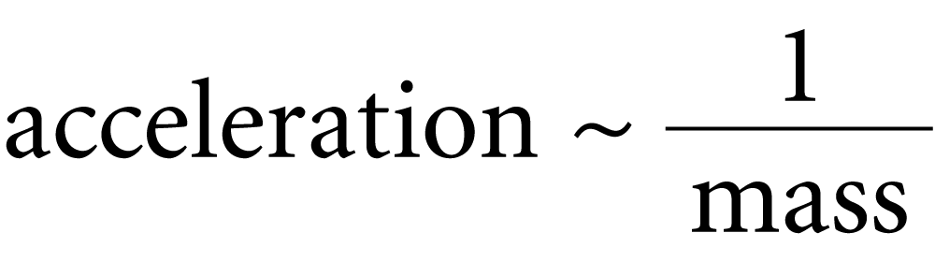
Mass Resists Acceleration
The same force applied to twice as much mass results in only half the acceleration.
The acceleration is inversely proportional to the mass.
Inversely means that the two values change in opposite directions. As the denominator increases, the whole quantity decreases by the same factor.

Slide 6
Newton’s Second Law
Newton’s second law states that the acceleration produced by a net force on an object is directly proportional to the magnitude of the net force, is in the same direction as the net force, and is inversely proportional to the mass of the object.

Slide 7
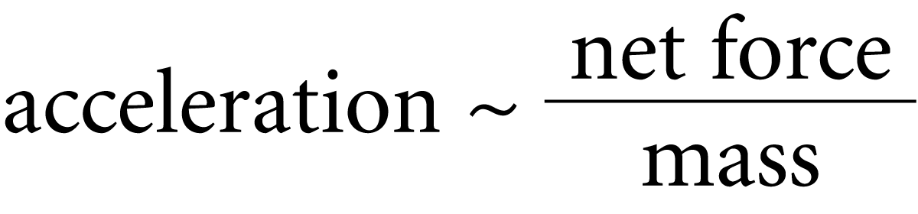
Newton’s Second Law
Newton’s second law describes the relationship among an object's mass, an object's acceleration, and the net force on an object.

Slide 8
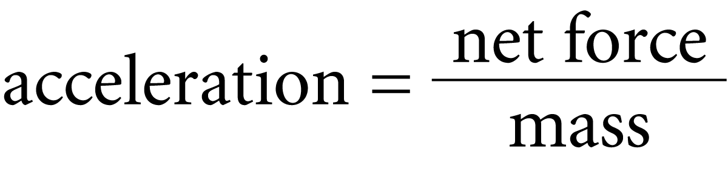
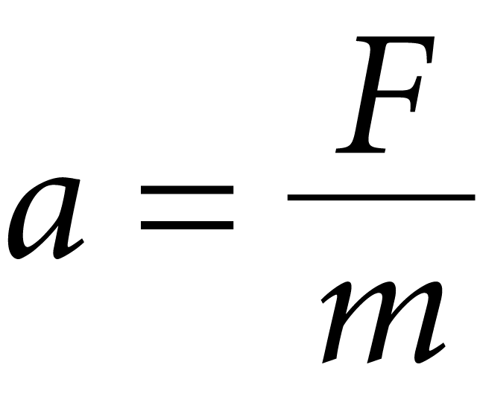
Newton’s Second Law
By using consistent units, such as newtons (N) for force, kilograms (kg) for mass, and meters per second squared (m/s²) for acceleration, we get the exact equation:
If a is acceleration, F is net force, and m is mass,

Slide 9

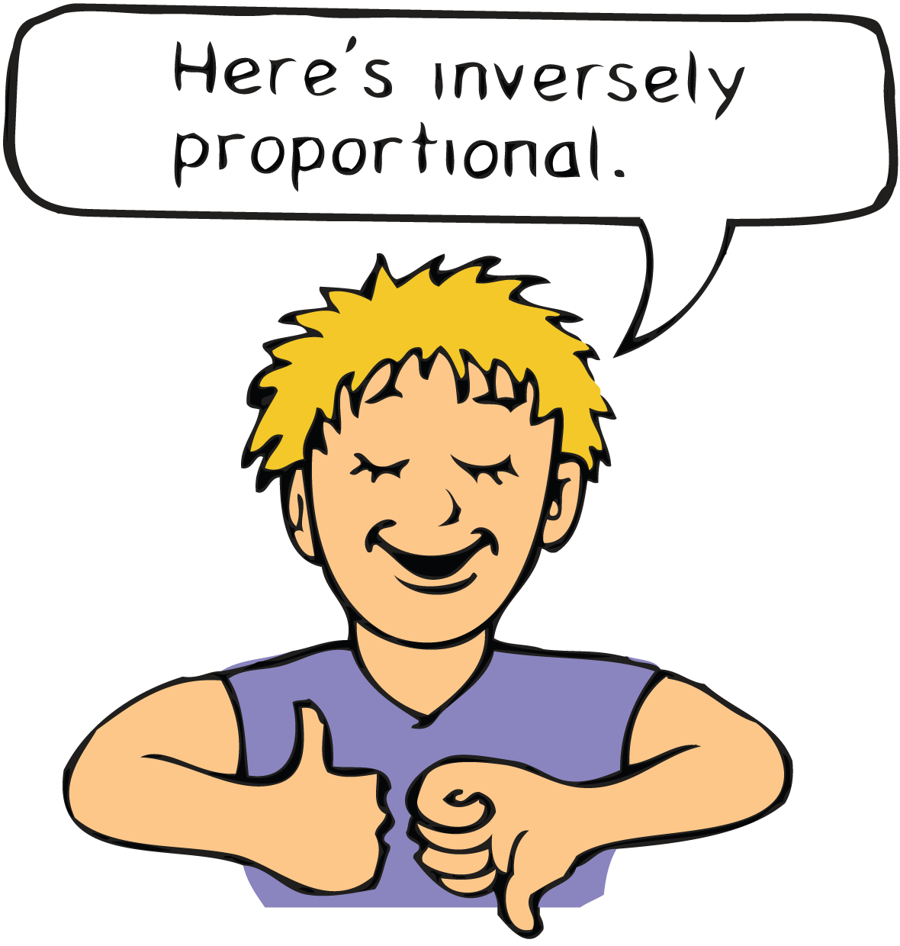
Newton’s Second Law
The acceleration is equal to the net force divided by the mass.
  If the net force acting on an object doubles, its acceleration is doubled.
  If the mass is doubled, then acceleration will be halved.
  If both the net force and the mass are doubled, the acceleration will be unchanged.

Slide 10
think!
If a car can accelerate at 2 m/s², what acceleration can it attain if it is towing another car of equal mass?

Slide 11
think!
If a car can accelerate at 2 m/s², what acceleration can it attain if it is towing another car of equal mass?
Answer: The same force on twice the mass produces half the acceleration, or 1 m/s².

Slide 12
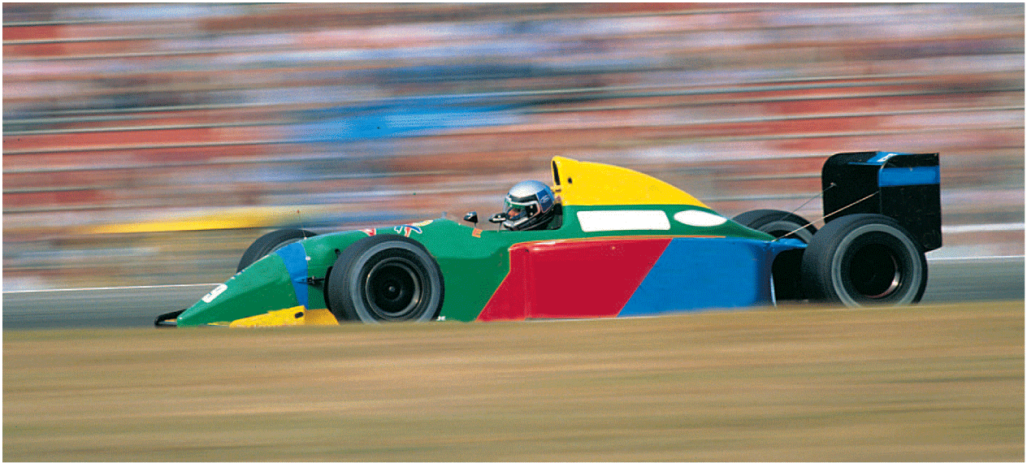
do the math!
A car has a mass of 1000 kg. What is the acceleration produced by a force of 2000 N?

Slide 13
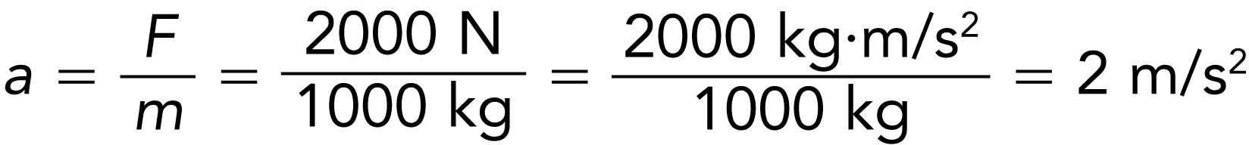
do the math!
A car has a mass of 1000 kg. What is the acceleration produced by a force of 2000 N?

Slide 14
do the math!
If the force is 4000 N, what is the acceleration?

Slide 15
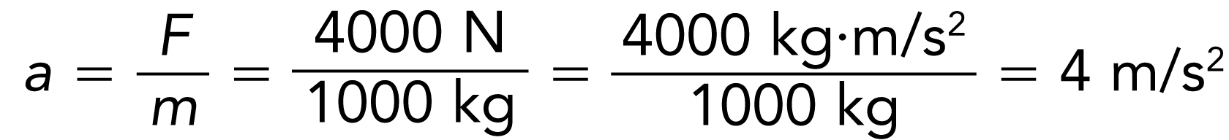
do the math!
If the force is 4000 N, what is the acceleration?
Doubling the force on the same mass simply doubles the acceleration.

Slide 16
do the math!
How much force, or thrust, must a 30,000-kg jet plane develop to achieve an acceleration of 1.5 m/s²?

Slide 17
do the math!
How much force, or thrust, must a 30,000-kg jet plane develop to achieve an acceleration of 1.5 m/s²?
Arrange Newton’s second law to read:
force = mass × acceleration
F = ma
= (30,000 kg)(1.5 m/s²)
= 45,000 kg•m/s²
= 45,000 N

Slide 18

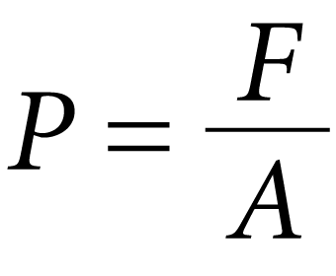
Applying Force-Pressure
The amount of force per unit of area is called pressure.
When the force is perpendicular to the surface area,
P is the pressure and A is the area over which the force acts.
Pressure is measured in newtons per square meter, or pascals (Pa). One newton per square meter is equal to one pascal.

Slide 19
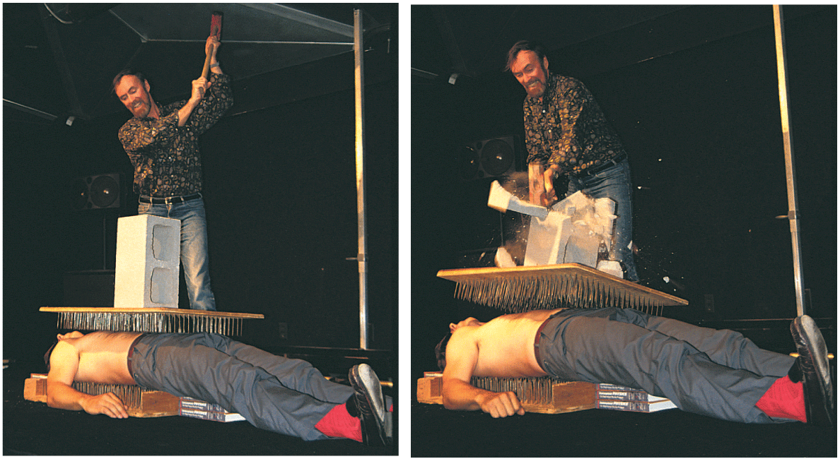
Applying Force-Pressure
The driving force per nail is not enough to puncture the skin.
CAUTION: Do not attempt this on your own!

